Slide 1
Welcome to my presentation
Submitted by
Jalal Uddin Rumi
EDGE ID: 14 (Office 67)
Department of Physics
University Of Barishal.
Submitted to
Md Mahbub E Noor
Assistant Professor
Department of CSE
University of Barishal

Slide 2
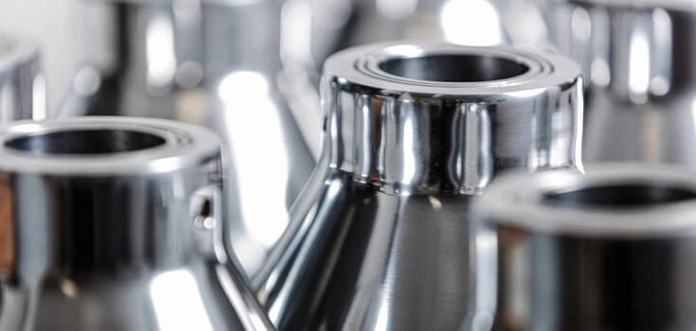
My topic is Stellie Alloy

Slide 3
Table of content
Information about the metal pieces used to develop the alloy
Excel Functions used in this project
Stellite is made from an alloy of 5 metals
Key points about Stellite alloy characteristics
Uses of Stellite Alloy

Slide 4
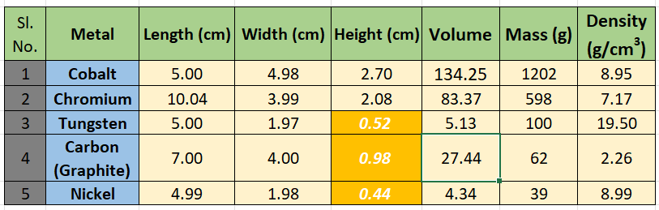
Information about the metal pieces used to develop the alloy:

Slide 5

Excel Functions used in this project:
Sum;
Example =SUM(A1:A10)
Product;
Example =PRODUCT(A1:A10)
DIVISION;
Example=A1/B1
AVERAGE;
Example=AVERAGE(B1:B10)
VLOOKUP
Example=VLOOKUP(D1, A1:B10, 2, FALSE)
LOOKUP
Example =LOOKUP(lookup_value, lookup_vector, [result_vector])
HLOOKUP
Example=HLOOKUP(lookup_value, table_array, row_index_num, [range_lookup])

Slide 6
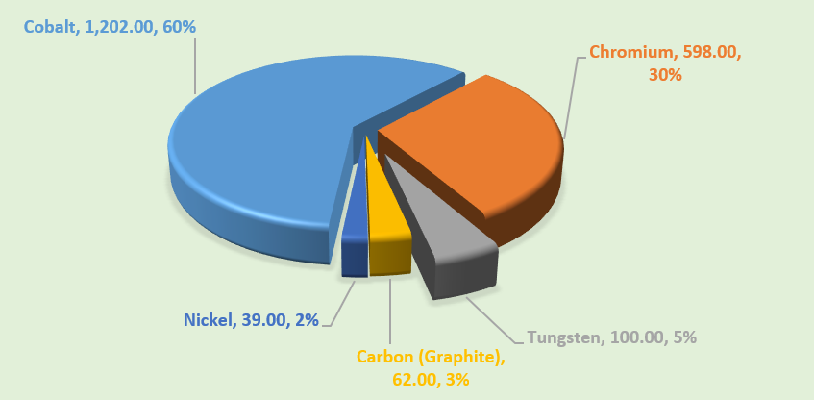
Stellite is made from an alloy of 5 metals.

Slide 7
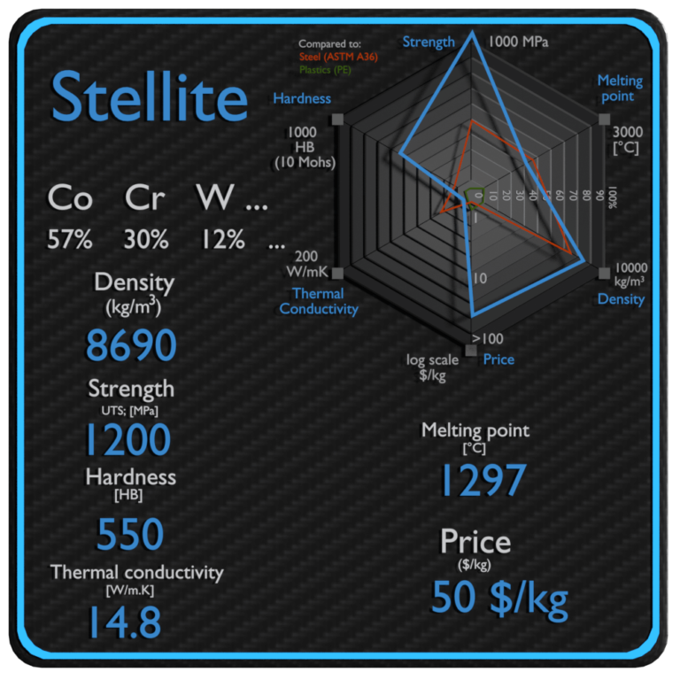
Key points about Stellite alloy characteristics:
High wear resistance
Corrosion resistance
High-temperature strength
Oxidation resistance
Impact resistance
Cavitation resistance
Versatility in different grades

Slide 8
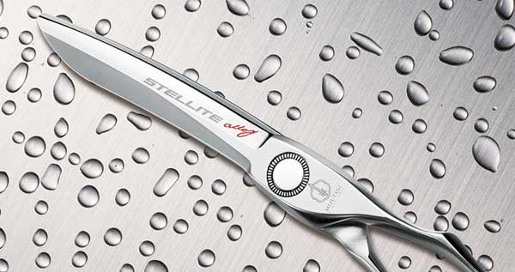
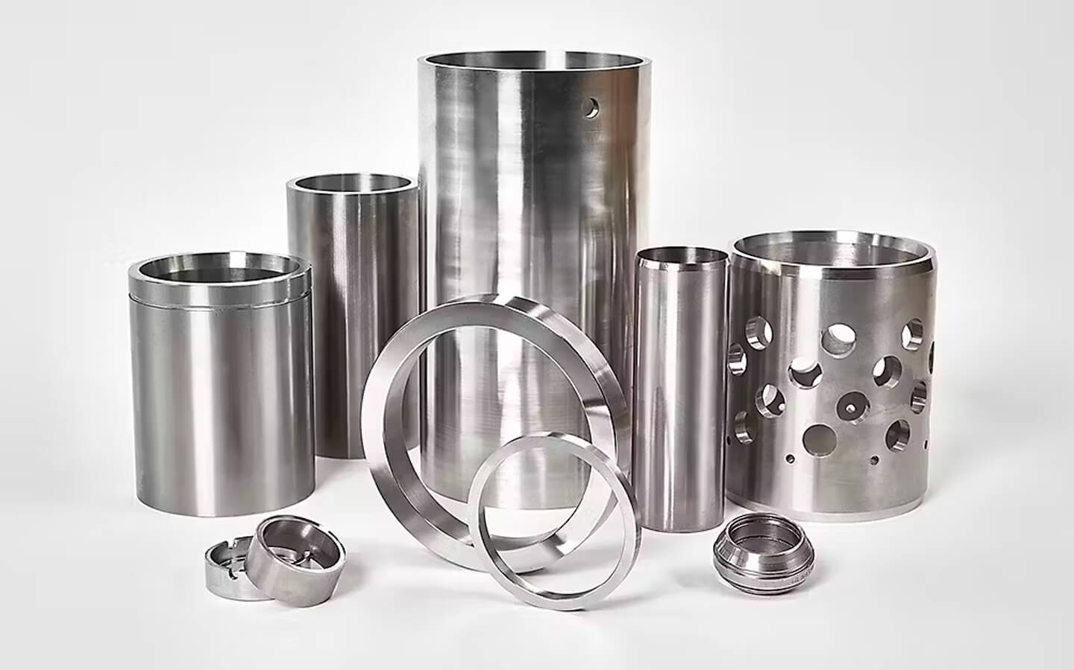
Uses of Stellite Alloy:
Cutting tools
Valve seats and engine
Bearings
Aerospace and turbine
Medical instruments
Dies and molds
Mining and drilling equipment

Slide 9

Any Question?

Slide 10

Thank You

